Slide 1
House Price Prediction - BA with R project Fall’17
Agenda
Understanding the problem
Understanding the data and overview of approach
Data cleaning and feature engineering
Overview of modeling
Exploratory data analysis
Multiple linear regression
Decision Tree
Random Forest
Comparing different models and Final Model

Slide 2
Understanding the Problem
Problem at Hand
Everyone has a dream to “own a house” and being conscious about the price of the property is very important when buying a new one. Multiple information sources like websites, reality tv shows and dealers/brokers create a lot of confusion.
What if, a machine estimates the price based on the characteristics of the property!
Project Objective is to identify the relationship between characteristics of the property and price of the property and identify best approach to predict the price of the property.
Project Objective
Data Information
Second-hand cross-sectional data about the properties sold in Iowa from 2006 to 2010
Data has information about 2930 properties
Data has 80 different variables that define different physical attributes of the property
Caution
Data is about the price of the properties in Iowa and since the price of the property changes from state to state, our predictions might be valid only for estimating the property prices in Iowa
Data has information only till 2010 and for adjusting to present scenario “change in property price from 2010 to present” can be used as adjustment factor

Slide 3
Understanding the data and Overview of Approach
Variables
Dataset has comprehensive attributes of houses consisting of 36 numerical and 45 categorical variables
Data covers qualitative and quantitative aspects ranging from:
Indoor Variables: bedrooms, kitchen, bathrooms, fireplaces etc..
Outdoor Variable: Type of foundation, exterior covering of the house, pool, garage etc..
Other Variables: Location, year sold, type of sale, condition of sale etc..
Overview of Approach
EDA
&
Data Cleaning
Linear
&
Non-Linear Models
Comparing different models
Missing Value Treatment
Outlier Treatment
Linear Regression
Decision Trees
Random Forest

Slide 4
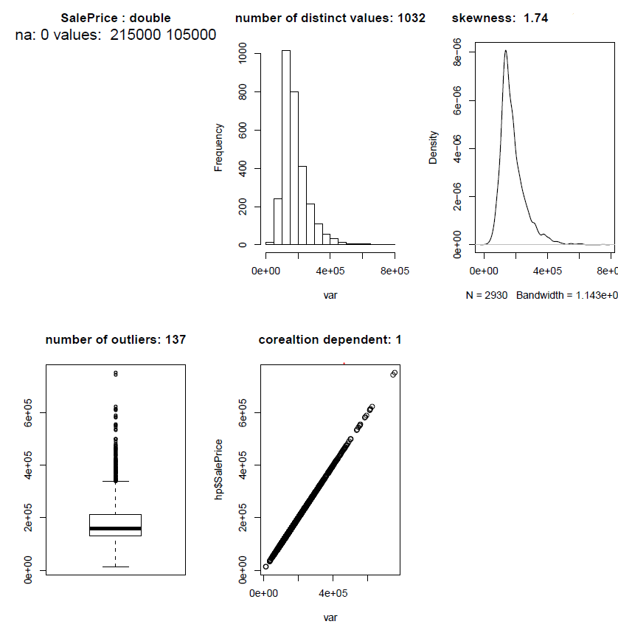
Data Cleaning and Feature Engineering
1. Descriptive Information for all variables
Sample output for Sale Price
2. Missing Value Treatment
Predicting missing values based on the domain knowledge if % of missing observations in a variable is more than 5%
Example: Predicting missing values of a ‘Lot Frontage’ (Linear feet of street connected to property) using Neighborhood and House Style
<1% of the data has been lost after removing observations which haven’t been imputed using any method
Example:
Number of missing values
Data type of the variable
Skewness and density plot
Box Plot and Number of outliers
3. Outlier Treatment and Variable removal
4. Feature Engineering
Winsorize top 2.5% of the variables, if more than 5% of the observations are outliers
For a categorical variable, if more than 95% of the observations belong a particular category or Avg. ‘Sale Price’ is the same across categories then that variable is removed
Creating new variable from the existing data
Example:
Age of the house
Age of the house since remodel
If a second material has been used for external covering

Slide 5

Overview of Modeling
Post Data-Treatment
66 predictor variables
41 categorical and 25 numerical
2,912 observations
Modeling
Linear
Non-Linear
Data has been divided into 80% training and 20% test
Evaluation Metric: Root Mean Squared Logarithmic Error between the predicted value and the observed sales price. (Taking logs means that errors in predicting expensive houses and cheap houses will affect the result equally)
Decision Tree (CART)
Modeling Approaches
Multiple Linear Regression
Random Forest
Formula
Baseline RMSE: Actual: ‘Sale price’, Predicted: ‘Average Sale Price’
Baseline RMSE for train data : 0.41
Baseline RMSE for test data : 0.43

Slide 6
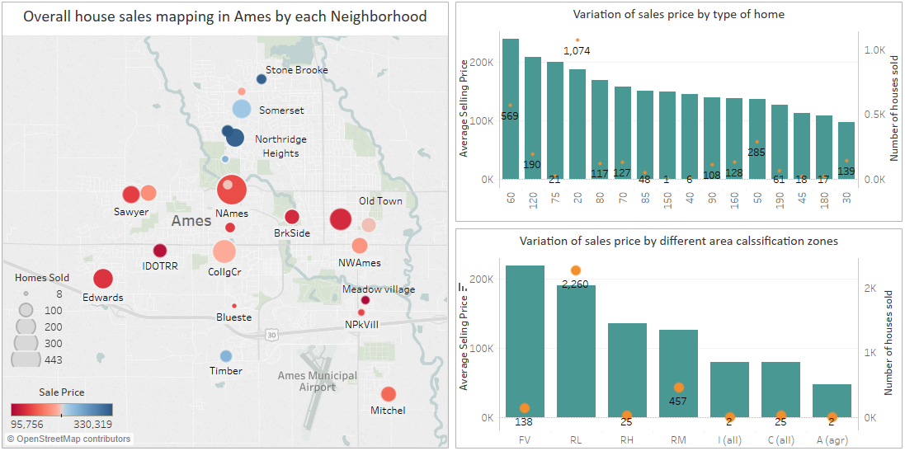
Most of the houses sold in Ames are 1 Story Newer Houses in Residential House Density Areas
Notes:
How did the avg. price of a house change across different years?
houseage
Houseageafterremodel
Total Bsmt SF
Gr Liv Area

Slide 7
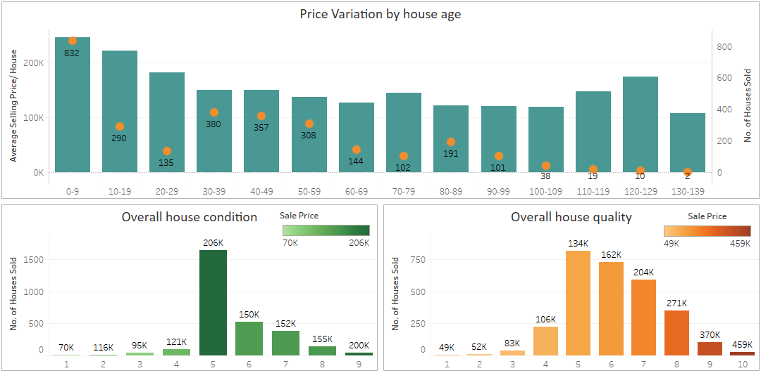
Impact of Age, Condition and Quality on Sale Price of the house

Slide 8
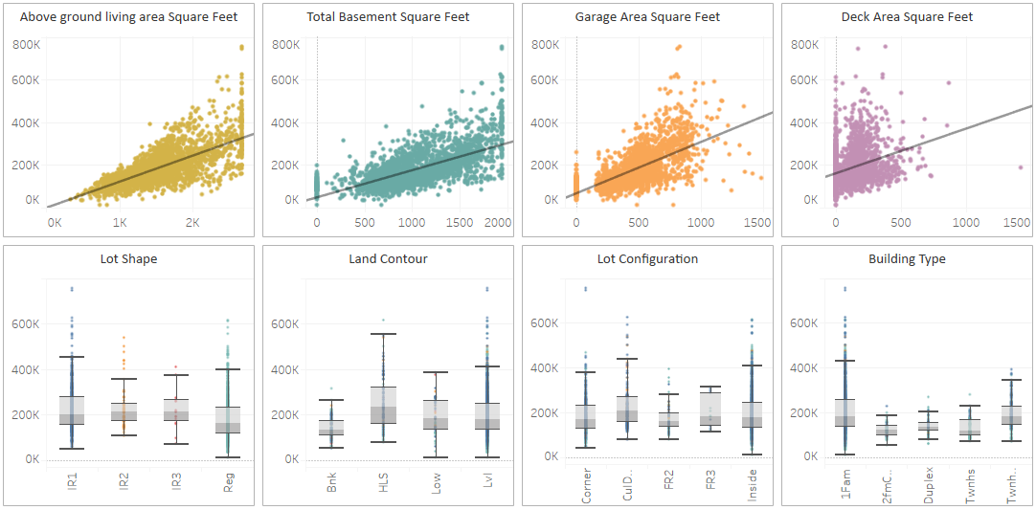
Variation In Sales Price with respect to various variables

Slide 9
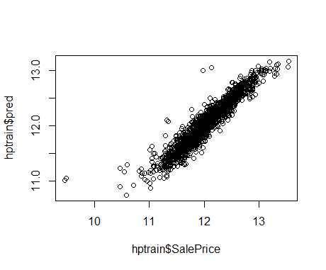
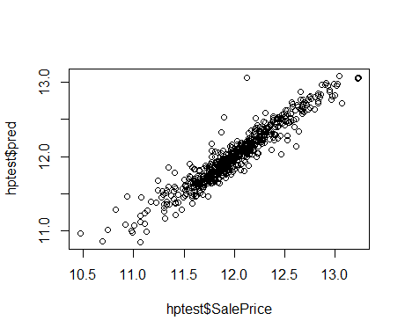
Models – Multiple Linear Regression
About the Model
Attributing variation in ‘Sale Price’ using variation in the explanatory variables
Transformations on data
Different assumptions like Normality, linear relationship, correlation plots and skewness have been checked for all the variables of interest. 12 variables have been transformed
Model Equation
After removing the insignificant variables, final model with all variables significant at p-value of 0.05
LotArea, Overall Quality, Overall Condition, Gr.Liv.Area, Neighborhood, Total.Bsmt.SF, BsmtFin.SF.1 and Garage Cars has a positive relationship with the dependent variables. Rest of the variables has a negative relationship.
Adjusted R-squared = 0.8972
RMSE
Plot of actual vs predicted ‘Sale Price’ for train data
Plot of actual vs predicted ‘Sale Price’ for test data
Train data RMSE: 0.12
Test data RMSE: 0.13

Slide 10
Models – Decision Trees
About the Model
Regression Tree Algorithm - Hierarchical way of partitioning; divide recursively
180e+3 100% Overall Qual < 7.5
157e+3 84%
132e+3
50% 1st Flr SF < 1247
192e+3
34%
Gr Liv Area< 1726
302e+3 16%
Overall Qual < 8.5
271e+3 12% Gr Liv Area < 1920
382e+3 4% Gr Liv Area < 2229
124e+3
40% Overall Qual < 4.5
166e+3 10%
177e+3 24% Total Bsmt SF < 1331
243e+3 7%
313e+3 5%
340e+3 2%
442e+3 2%
228e+3 10%
Decision tree for Sale Price based on certain significant variables:
Overall Quality, Neighborhood, First Floor Square feet, Above Ground Living area, Total Basement Square feet
Significant Variables
Decision Tree
Neighborhood = Blueste, BeDale, BrkSide, EdWards, IDOTRR, Mitchel, OldTown
RMSE
Train data RMSE: 0.20
Test data RMSE: 0.22

Slide 11
Models – Random Forest
About the Model
A Random Forest model using bootstrap aggregation
Significant Variables
Significant variables to predict SalesPrice:
Overall Quality, Neighborhood, Garage Cars, Above ground living area, External Quality, Basement Quality, Total basement area, House age, 1st floor area, Garage area
Ser.no | Left daughter | Right Daughter | split var | split point | status | Prediction
1 | 2 | 3 | Exter.Qual | 10 | -3 | $ 179,470
2 | 4 | 5 | Gr.Liv.Area | 1387.5 | -3 | $ 143,331
3 | 6 | 7 | Garage.Cars | 2.5 | -3 | $ 242,724
4 | 8 | 9 | Total.Bsmt.SF | 989 | -3 | $ 124,966
5 | 10 | 11 | Neighborhood | 9223304 | -3 | $ 169,267
6 | 12 | 13 | Total.Bsmt.SF | 1405.5 | -3 | $ 206,234
7 | 14 | 15 | Total.Bsmt.SF | 1841 | -3 | $ 325,387
8 | 16 | 17 | Overall.Qual | 4.5 | -3 | $ 114,061
9 | 0 | 0 | <NA> | 0 | -1 | $ 181,500
10 | 0 | 0 | <NA> | 0 | -1 | $ 326,650
Example Result
RMSE
Train data RMSE: 0.06
Test data RMSE: 0.14

Slide 12
Comparing different models and Final Model
Variable Importance in different models
Across all the models, 4 variables are significant/important
Overall Quality
Gr.Liv.Area
Neighborhood
Total.Bsf
RMSE
All the models have less RMSE compare to than the baseline model
In all the models test RMSE is more than train RMSE
Least RMSE for both test and train dataset has been observe by combining MLR and Random Forest
Dataset | Baseline | Multiple Linear Regression | Decision Tree | Random Forest | MLR + Random Forest
Train | 0.41 | 0.12 | 0.20 | 0.06 | 0.11
Test | 0.43 | 0.13 | 0.22 | 0.14 | 0.13

Slide 13
Thank you - Any Questions?

